Slide 1

Load Balancing Techniques and Algorithms in Distributed System
Type 2: Review and Design
Sonal Ingle (YV16051)
Shubhi Shrivastava (NN46376)
Tanvi Kulkarni (UV 93494)
Karan Dhamecha (PS91095)

Slide 2
Source for literature review
Survey on Load Balancing Techniques https://www.researchgate.net/publication/331034889_Survey_on_Load_Balancing_Techniques
Improved Dynamic Load Balancing Algorithm Based on Least-Connection Scheduling https://ieeexplore.ieee.org/document/8740642.
Different technique of load balancing in distributed system: A review paper. https://ieeexplore-ieee-org.proxy-bc.researchport.umd.edu/stamp/stamp.jsp?tp=&arnumber=7342686&tag=1

Slide 3
Introduction
In our project we are discussing how load balancer plays a crucial role in distributing incoming network traffic across a group of backend servers for network and application layers and what are the different algorithms it uses for doing so. Different load balancing algorithms provide different benefits and depending upon the situation you can choose the one that is best suited in that situation. Load balancing algorithms falls in two main categories – weighted and non-weighted algorithms. Weighted algorithms use a calculation based on weight or preference to make the decision for example servers with more weight receives more traffic. Whereas non-weighted algorithms make no such distinctions, instead it assumes that all the servers have the same capacity. We will be discussing in detail about various algorithms that are implemented at Network and application layer which includes Round Robin, Weighted Round Robin, Least Connection, Weighted Least Connection and Random.

Slide 4
Different Load Balancing Algorithms
Round Robin
Weighted Round Robin
Least Connection
Weighted Least connection
Random

Slide 5
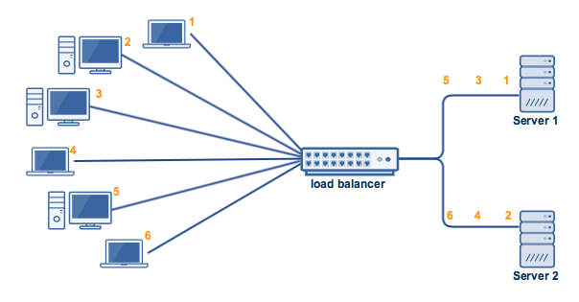
Round Robin Algorithm
Pros
Widely used and easy to implement.
The requests are equally divided among the available servers in an orderly fashion.
Cons
Different processing capacity servers may lead to crash.

Slide 6
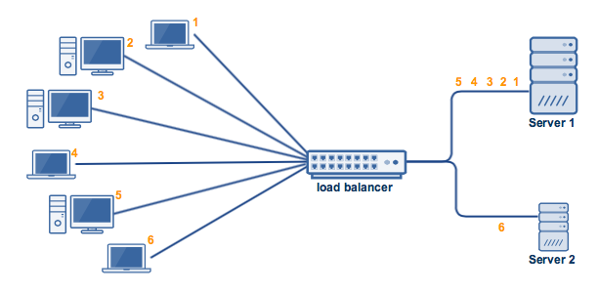
Weighted Round-Robin Algorithm
Pros:
Takes care of the capacity of servers in the group.
Cons:
Does not consider the advanced load balancing requirements such as processing times for each individual request.
Disconnecting clients may cause total connections in one server to pile up

Slide 7
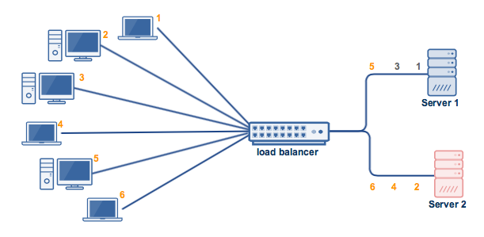
Least Connections Algorithm
Pros:
Prevents overloading
Cons:
Does not account for server capacity when determining number of current connections, i.e.) Server A has 10 connections and Server B has 20. The next request will be sent to Server A because it has less, however Server A may have a capacity of 12 connections while Server B has 50, making Server A more likely to become overloaded.

Slide 8
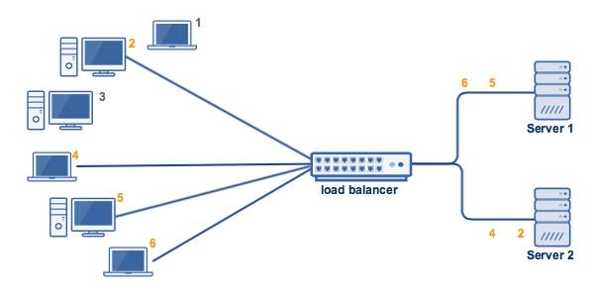
Weighted Least Connections Algorithm
Pros:
Takes into account both the capability of the server and the number of current connections to prevent overloading and crashing.
Cons:
Not scalable.

Slide 9
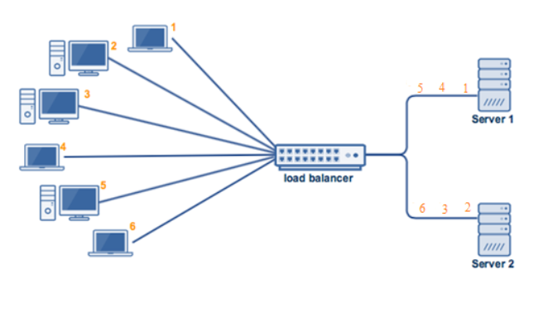
Random Algorithm
Pros:
Random distribution prevents too many connections to one server.
Cons:
Different processing capacity servers may lead to crash.

Slide 10
Proposed Design
Our proposed work is designed for n nodes(N1,N2…Nn).
Considering Load = L, CPU = C, Memory = M, bandwidth = B, Disk usage = D.
Prerequisites for i th node are:
The weight for node Ni is W=ai, which is pre-assigned to each machine. It is calculated on basis of machine parameters C,M,D,B.
The threshold T will be set for each machine depending on the machine capacity.
Server capacity is pre-calculated on all the nodes based on the parameters C,M,B,D.
Our proposed system adds a new server whenever there is resource crunch.
Hence the probability of system crash becomes negligible.

Slide 11
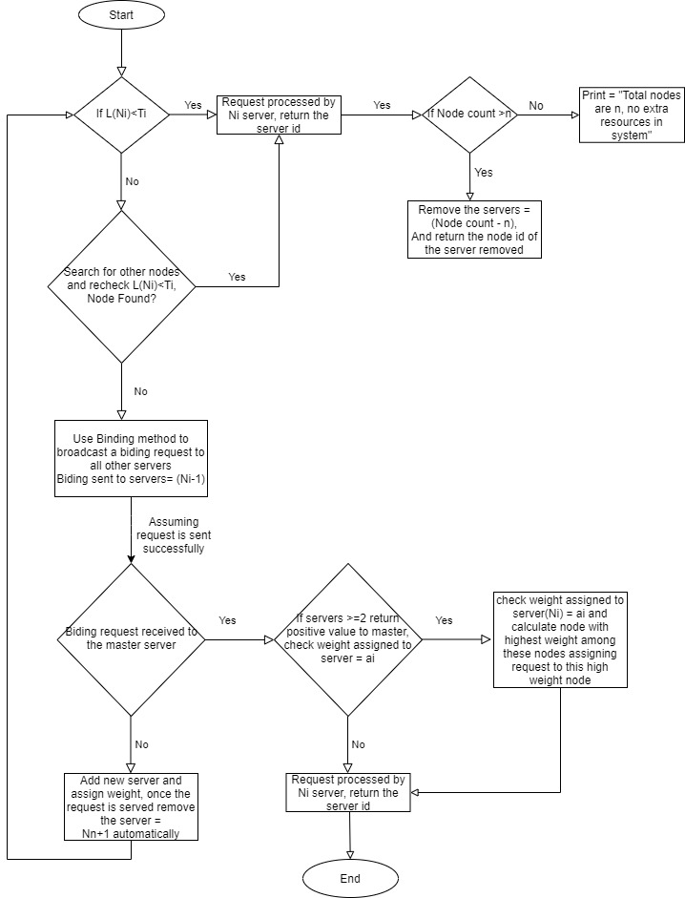
Proposed Design

Slide 12
Application of Proposed Design
The major application our proposed design will be used is e-commerce. Our proposed design is majorly used when the company has sudden exponential increase in the customer’s requests. During the “Black Friday Sale”, the retailers like Walmart, Kohl's, Macy's, Amazon, Target, and Best Buy have to handle huge requests. These increased requests demand more resources to function without any issues. This design allows scalability of the system increasing the throughput of the system. Whenever the number of requests increase more than the threshold of each node, then there is requirement of more resources. Hence a new server is added from the pool into the system which will be ready to handle further requests. Once the customer is done with the online shopping, the extra resources are not required. Once the request is complete, the extra server is removed. This minimizes the cost of the system while providing extra resources.
The response time is little high as compared to others because after the addition of new servers the local communication time will increase slightly. The other factors like performance and latency are improved in this model with scalability as additional factor. Hence while serving such huge requests, the probability of the system going offline is negligible.

Slide 13
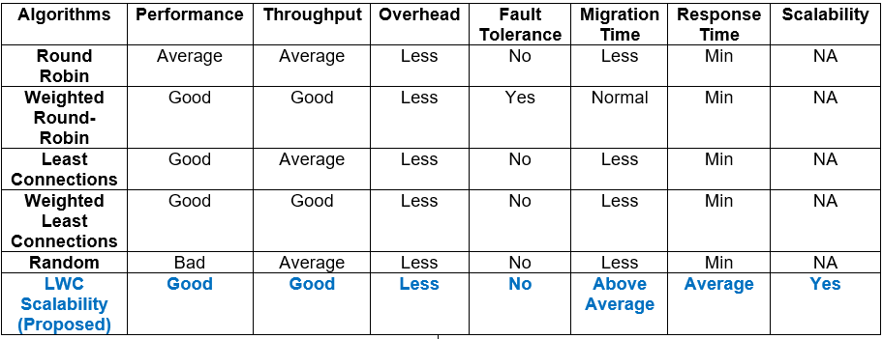
Comparison

Slide 14
Conclusion
In our project we discuss various load balancing algorithms in distributed environment used for network and application layers and also propose a designed algorithm which is basically a Weighted Least Connection algorithm scalability feature.
We also compare these algorithms based on different aspects such as performance, throughput, response time etc. And we can say each proposed algorithms has its own advantages and disadvantages.
For example, for the web related applications, a simple round robin technique would be sufficient to handle the download requests for the static web pages. Where as in dynamic applications for example in case of real time interactive applications, where the requests take longer than the others to process, advanced load balancing algorithms such as Least Connections or Weighted Least Connections can be used.
Whatever might be the load balancing technique we choose for an application, the chosen technique should be an efficient technique to handle the workload of the application in an efficient way.

Slide 15
Thank You
Stay Home! Stay Safe!

